Slide 1

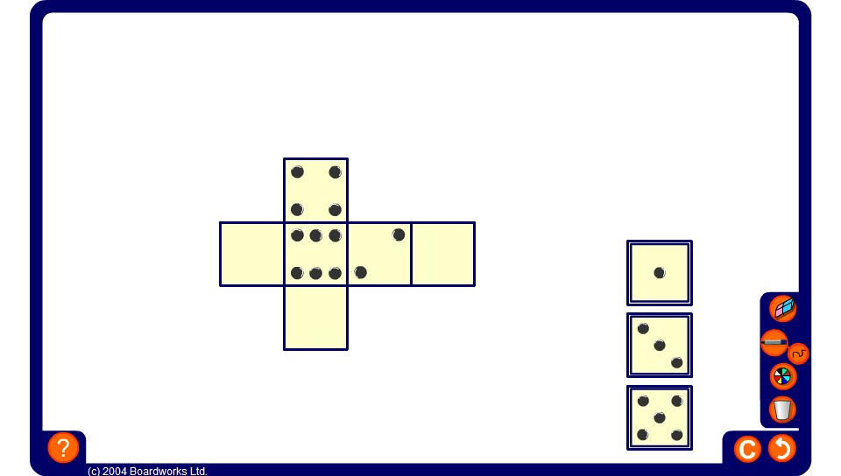


Nets of dice
Notes:
Use the fact that the opposite sides of a die add up to seven to drag the missing faces into place.

